Slide 1
Heaps

Slide 2
Binary Heaps
A binary heap is defined as a complete binary tree with elements at every node being either less than (or equal to) the element at its left and the right child.
It has following properties.
Since a heap is defined as a complete binary tree, all its elements can be stored sequentially in an array. It follows the same rules of complete binary tree. That is, if an element at position i in the array, has its left child stored at position 2i and its right child at position 2i + 1. Conversely, an element at position i have its Parent at position stored at position i/2.
Being a complete binary tree, all levels of the tree except the last level are completely filled.
Height of a binary tree is given as log2 n, where n is the number of elements.
Heaps (also known as partially ordered trees) are a very popular data structure for implementing priority queues.
A binary heap is a useful data structure in which elements can be added randomly but only the element with highest value is removed (in case of max heap and minimum value in case of mean heap). Although, a binary tree is better, but a binary heap is more space efficient, and simpler.

Slide 3
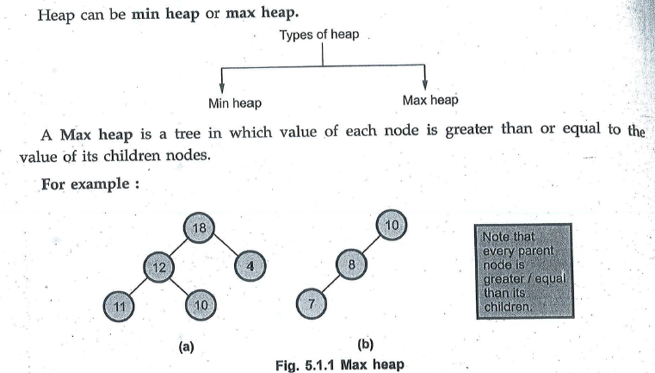
Heap is a Complete binary tree or a almost complete binary tree in which every parent node is either greater or lesser than its child nodes.

Slide 4
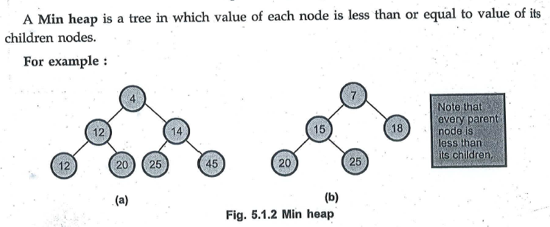

Slide 5
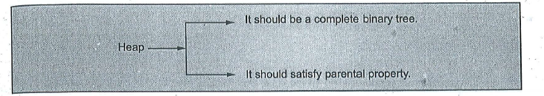

Slide 6
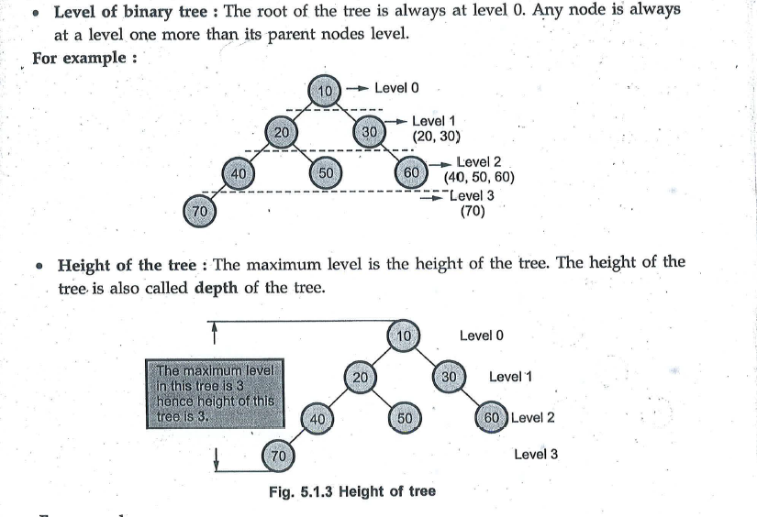
Few Basics

Slide 7
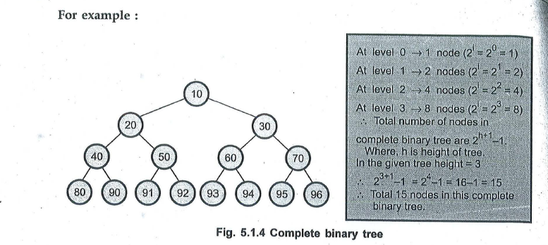

Slide 8
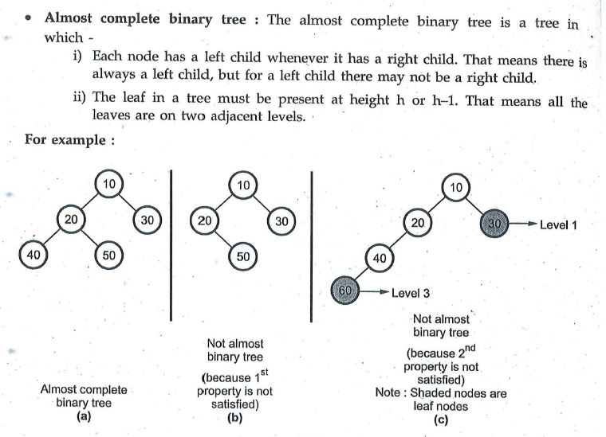

Slide 9
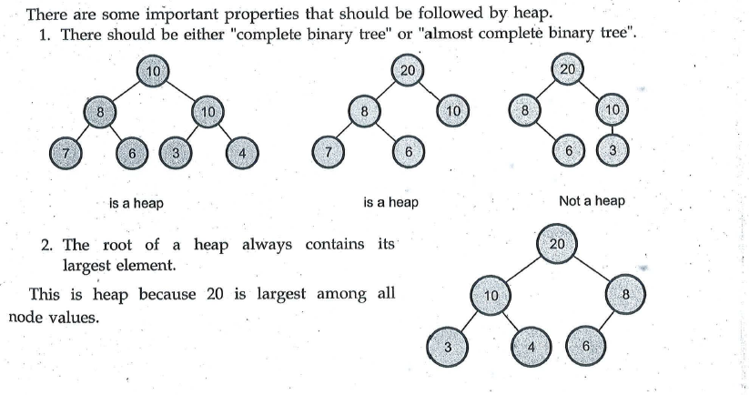
Properties of Heap

Slide 10
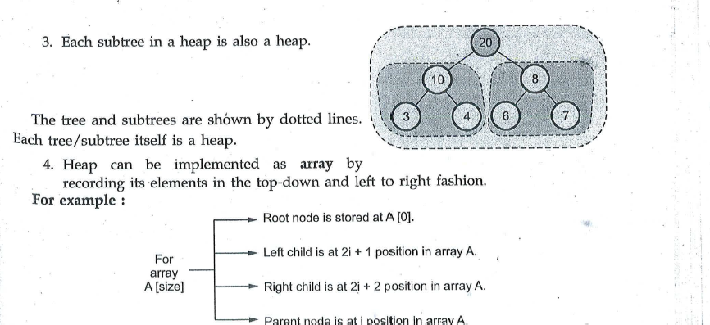

Slide 11
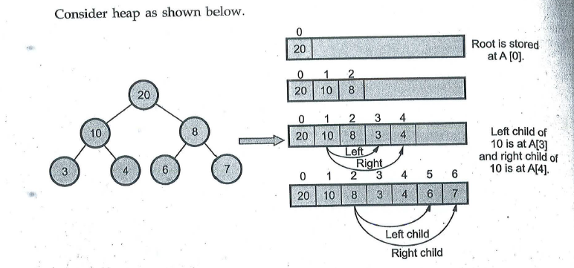

Slide 12
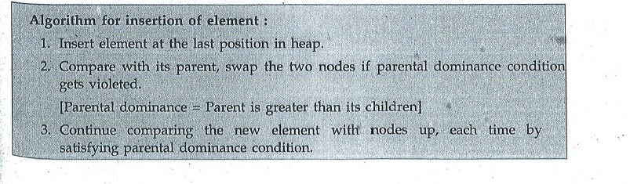
Insertion operation

Slide 13
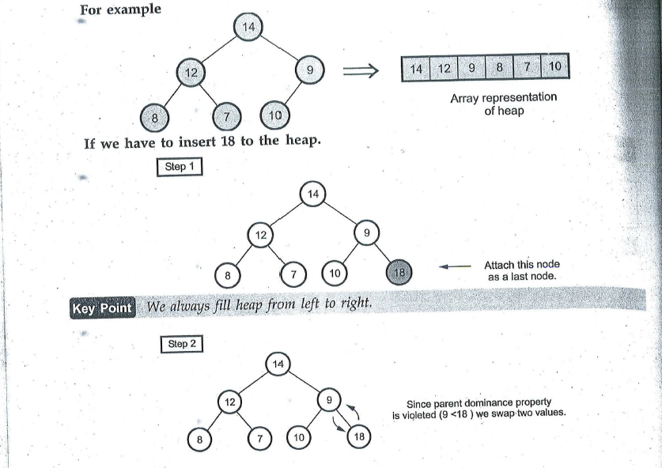

Slide 14
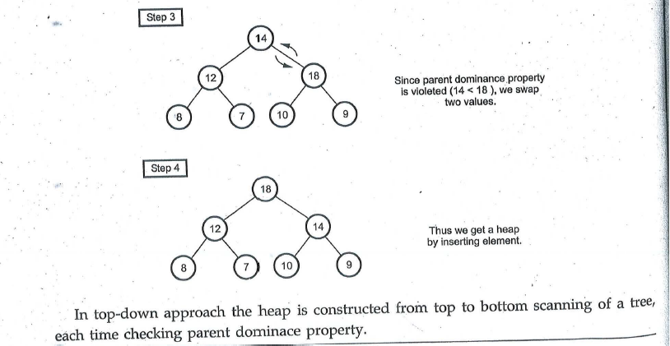

Slide 15
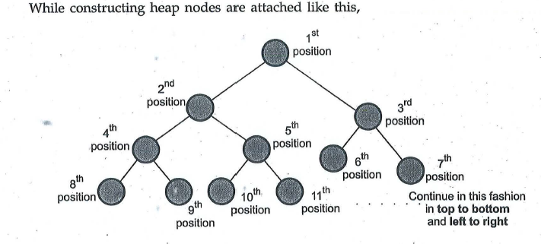

Slide 16
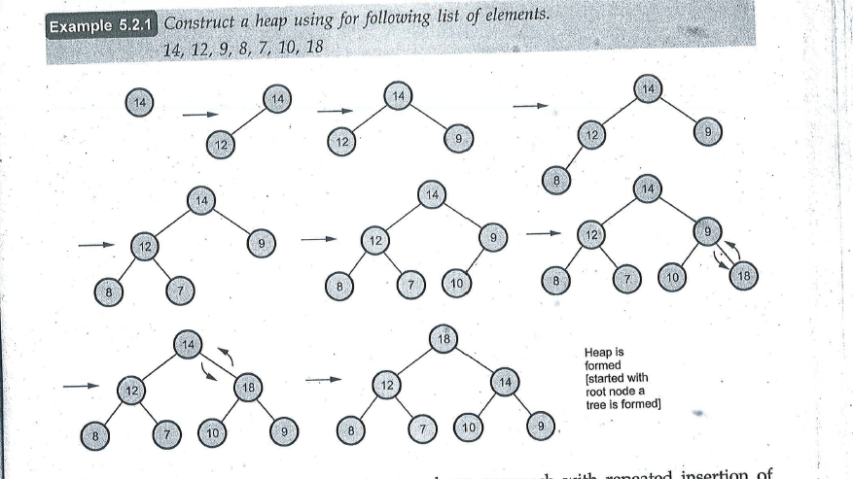

Slide 17
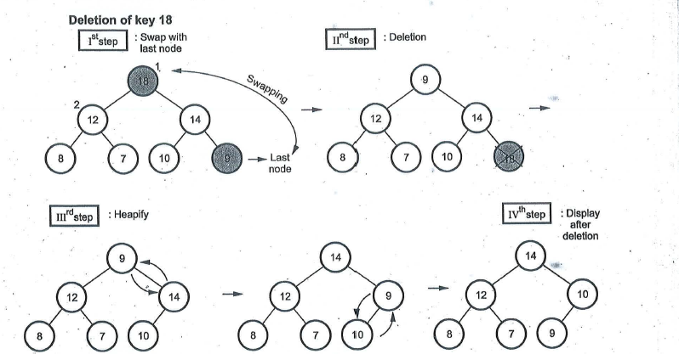

Slide 18
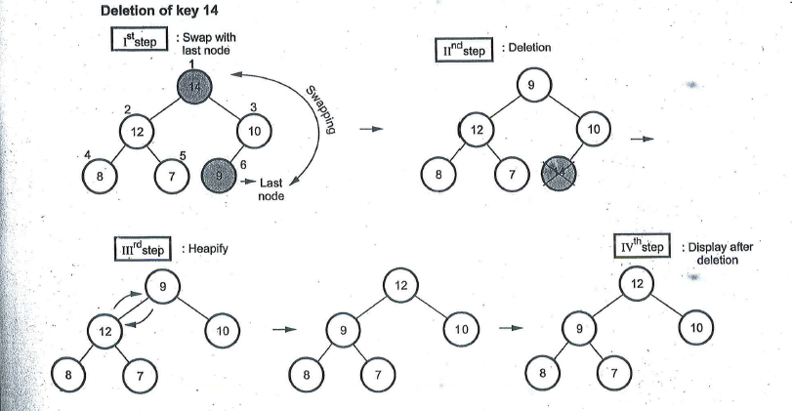

Slide 19
Insertion in a Binary Heap
Algorithm to insert a value in the heap
Step 1: [Add the new value and set its POS]
SET N = N + 1, POS = N
Step 2: SET HEAP[N] = VAL
Step 3: [Find appropriate location of VAL]
Repeat Steps 4 and 5 while POS < 0
Step 4: SET PAR = POS/2
Step 5: IF HEAP[POS] <= HEAP[PAR], then
Goto Step 6.
ELSE
SWAP HEAP[POS], HEAP[PAR]
POS = PAR
[END OF IF]
[END OF LOOP]
Step 6: Return

Slide 20
Deletion operation from Binary Heap
Consider a Max heap H having n elements .
An element is always deleted from the root of the heap
Deletion is done through following steps

Slide 21
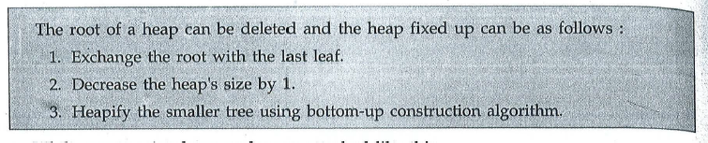
Deletion

Slide 22
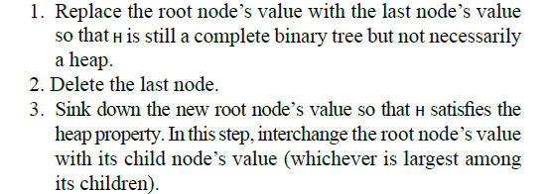

Slide 23
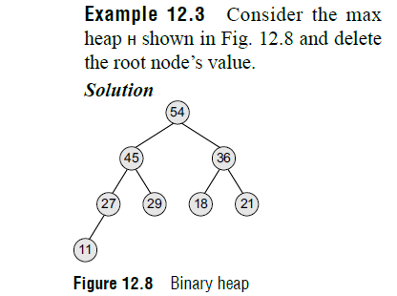

Slide 24
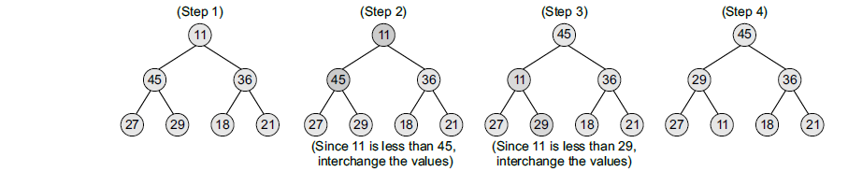

Slide 25
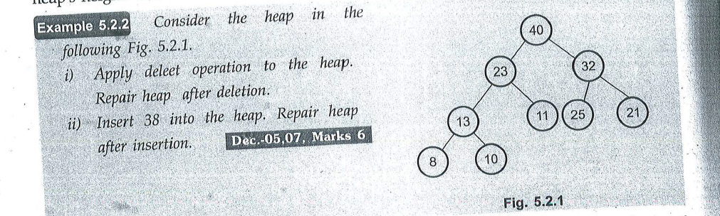

Slide 26
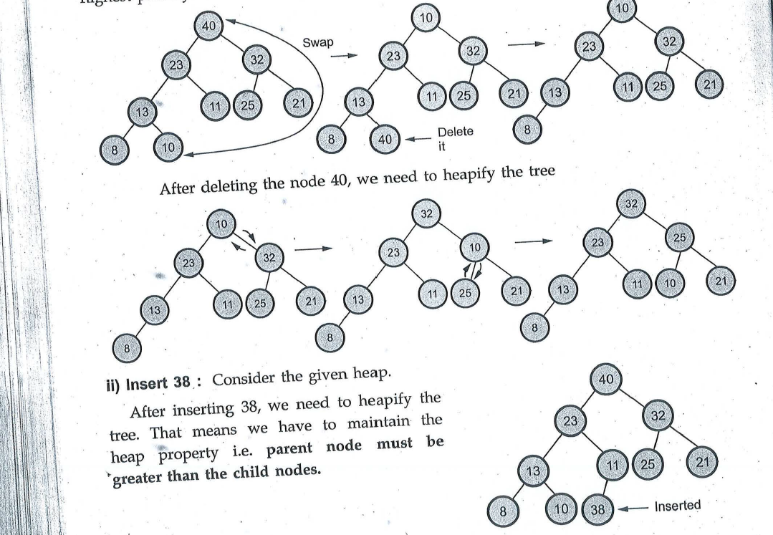

Slide 27
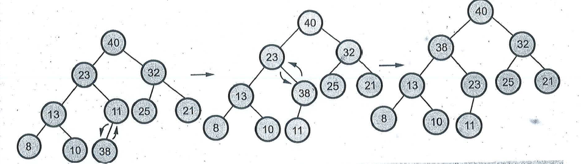

Slide 28
Insertion in a Binary Heap
Algorithm to delete the root element from the heap- DELETE_HEAP(HEAP, N, VAL)
Step 1: [ Remove the last node from the heap]
SET LAST = HEAP[N], SET N = N – 1
Step 2: [Initialization]
SET PTR = 0, LEFT = 1, RIGHT = 2
Step 3: SET HEAP[PTR] = LAST
Step 4: Repeat Steps 5 to 7 while LEFT <= N
Step 5: IF HEAP{PTR] >= HEAP[LEFT] AND HEAP[PTR] >= HEAP[RIGHT], then
Go to Step
[END OF IF]
Step 6: IF HEAP[RIGHT] <= HEAP[LEFT], then
SWAP HEAP[PTR], HEAP[LEFT]
SET PTR = LEFT
ELSE
SWAP HEAP[PTR], HEAP[RIGHT]
SET PTR = RIGHT
[END OF IF]
Step 7: SET LEFT = 2 * PTR and RIGHT = LEFT + 1
[END OF LOOP]
Step 8: Return

Slide 29
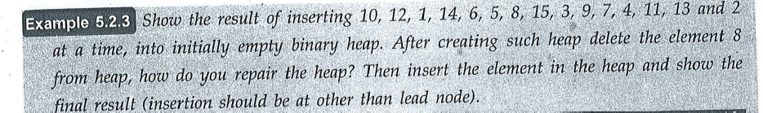

Slide 30
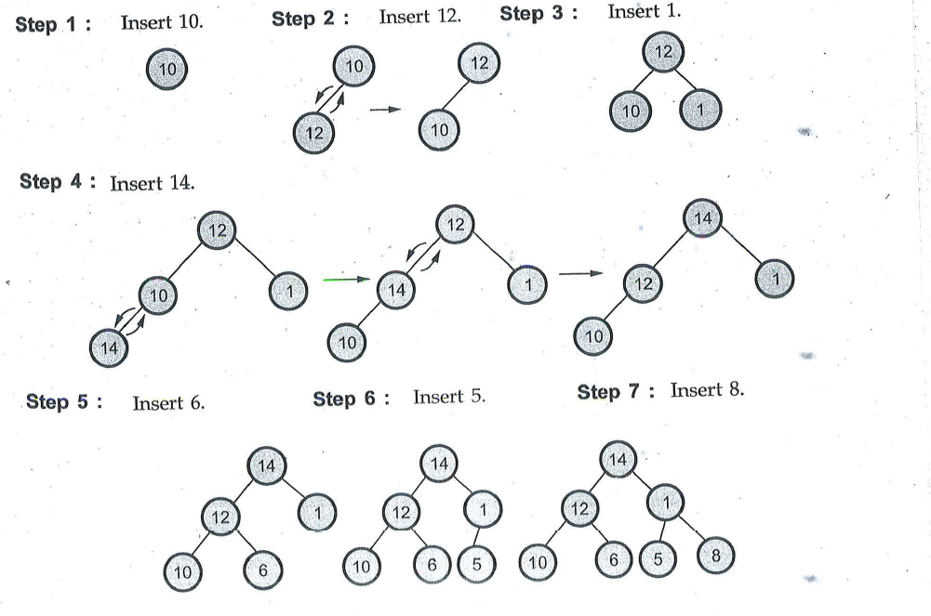

Slide 31
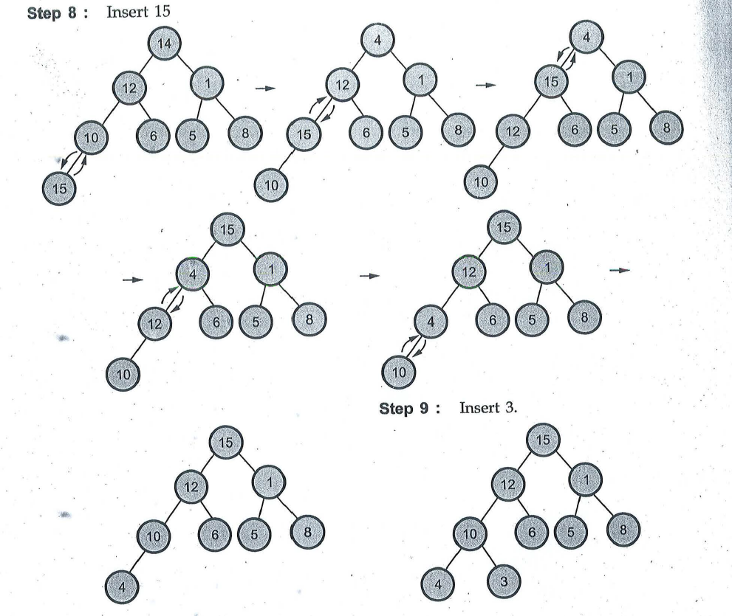

Slide 32
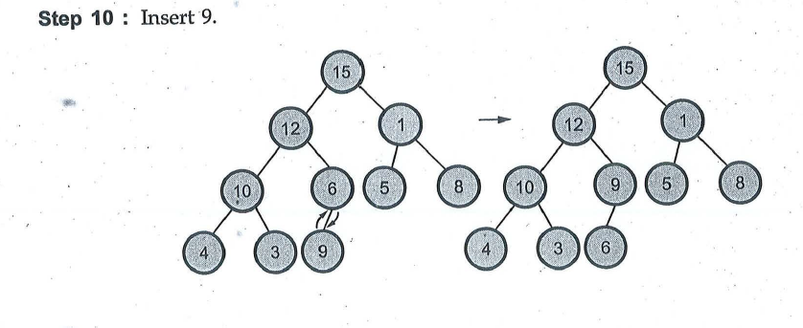

Slide 33
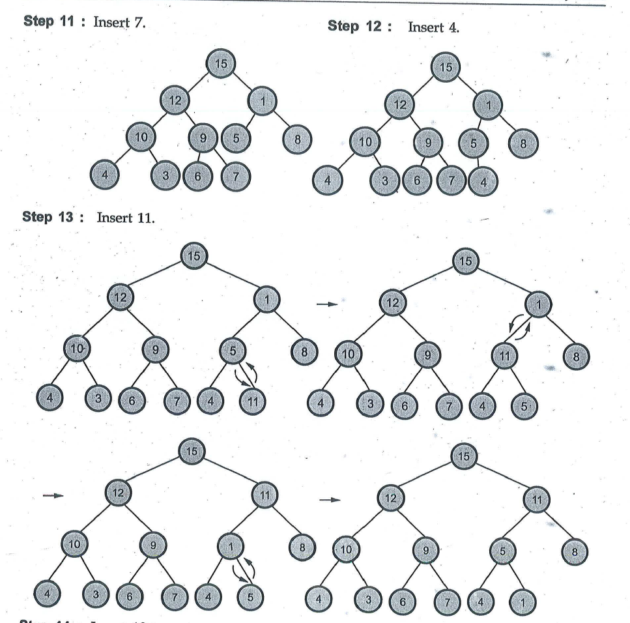

Slide 34
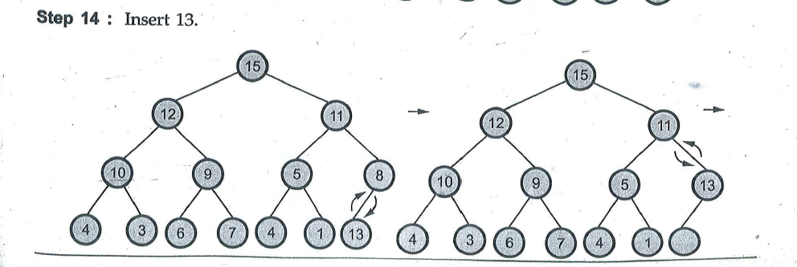

Slide 35
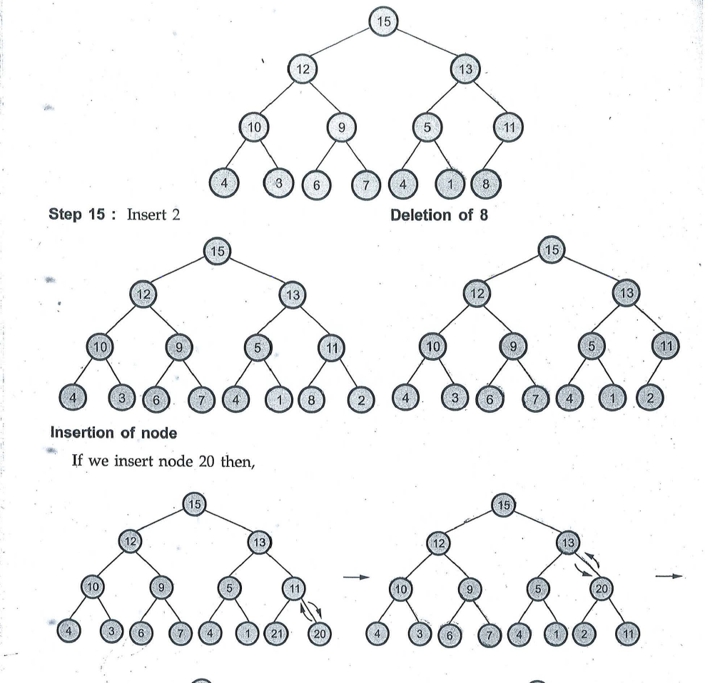

Slide 36
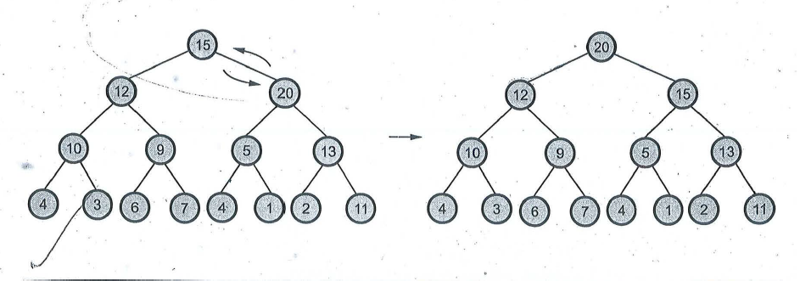

Slide 37
Applications of Binary Heap
Sorting an array Using Heap Sort Algorithm
Implementing Priority Queues

